Slide 1
Server Differences
what know?

Slide 2

Roles
Some of the common roles that you will see CyberPatriot Windows server images fulfill are:
Server Message Block (SMB)
used to share files
not an installed role, a bit more on the service side (Server service)
Internet Information Services (IIS)
used to handle services on the Internet. This may include FTP or Websites
Active Directory/Domain Name Services (AD/DNS)
AD is typically used to centralize maintenance in a large network
DNS is used to translate IP addresses into domain names
AD relies on DNS, usually these two services are paired up under one server.
And many more
hopefully these are the only three cuz CyberPatriot has only done these in the past

Slide 3
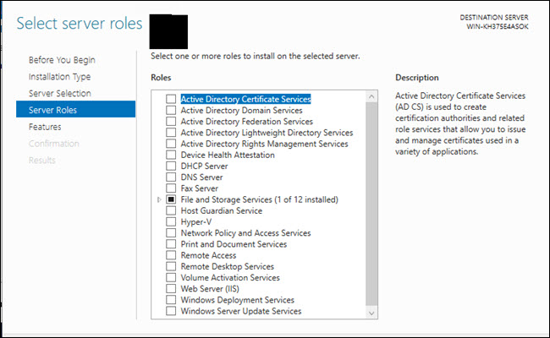
Roles in Server Manager

Slide 4
Features
Servers also have additional features that won’t be found in the workstation versions.
Whether or not you install those features are similar to Windows Features in Win 10
Windows Server Manager is considered a new feature where you can manage the features of your Windows Server
Clement thinks that the old versions of Windows Server Manager look like trash
One feature specific to Windows Server is Internet Explorer Enhanced Security or IE ESC
You should turn it on so put that in your checklist

Slide 5
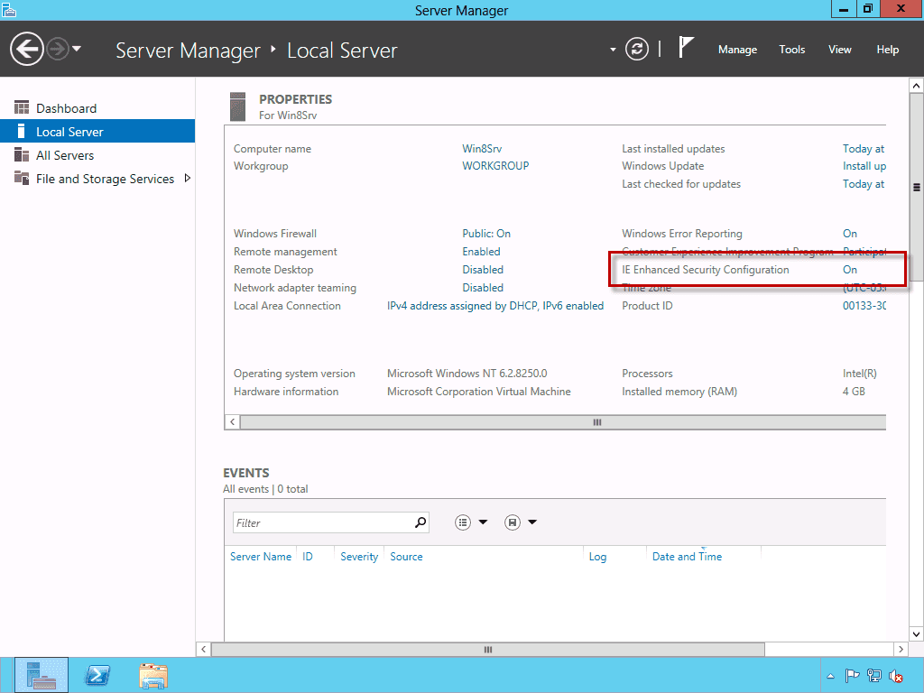
IE ESC status

Slide 6
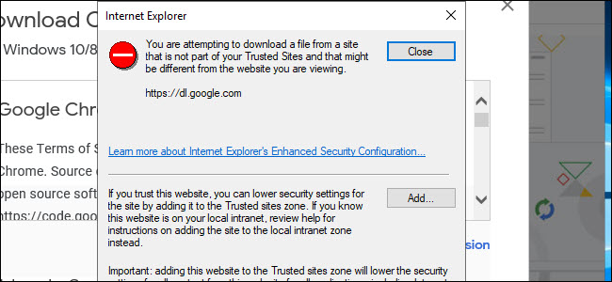
IE ESC in action

Slide 7
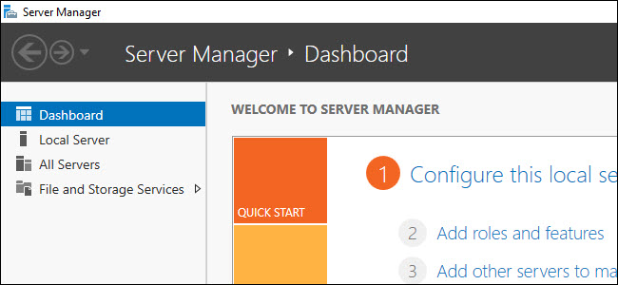
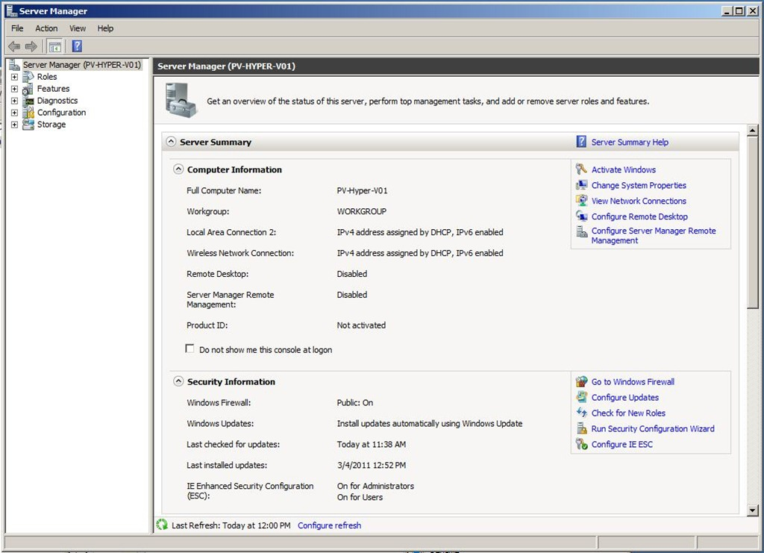
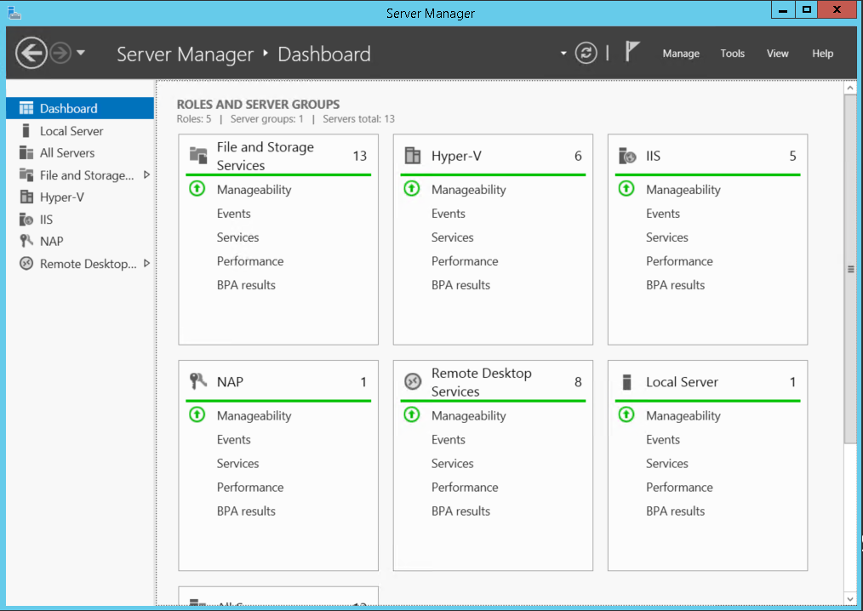
Server Manager over the years

